Slide 1
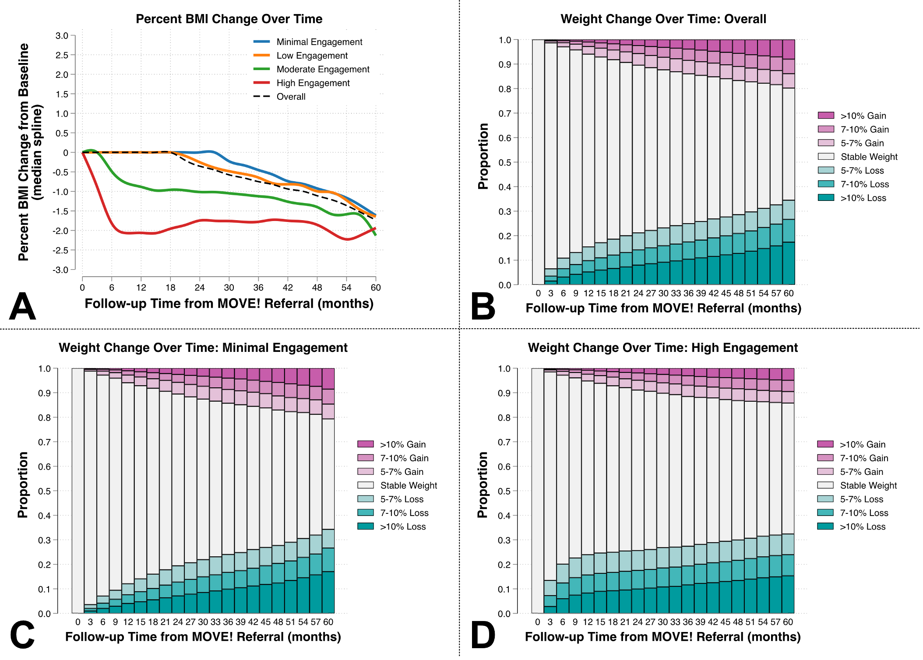





Weight Loss Programs and BMI Trajectory in Patients with Metabolic Dysfunction-Associated Steatotic Liver Disease: A Veterans Health Administration Study
Helen Tang MD¹, David E Kaplan MD MSc^{2,3}, Nadim Mahmud MD MS MPH MSCE^{2,3,4,5}
1 Department of Medicine, Perelman School of Medicine, University of Pennsylvania, Philadelphia, PA, USA; 2 Division of Gastroenterology and Hepatology, Perelman School of Medicine, University of Pennsylvania, Philadelphia, PA, USA; 3 Department of Medicine, Corporal Michael J. Crescenz VA Medical Center, Philadelphia, PA, USA; 4 Leonard Davis Institute of Health Economics, University of Pennsylvania, Philadelphia, PA, USA; 5 Center for Clinical Epidemiology and Biostatistics, Department of Biostatistics, Epidemiology & Informatics, Perelman School of Medicine, University of Pennsylvania, Philadelphia, PA, USA.
Research Aims
Results
Discussion
To evaluate the impact of referral to MOVE!, a nationally implemented behavioral weight loss program in the Veterans Health Administration (VHA), on weight trajectories in MASLD patients.
Figure 1: Median BMI Trajectory by Engagement Group (A) and Weight Change Categories in All Patients (B), Minimal Engagement Group (C), and High Engagement Group (D).
In this large VHA cohort of MASLD patients referred to MOVE! behavioral weight loss program, a minority of patients experienced significant weight loss through 5 years.
Patients with high engagement with the program had higher likelihood of weight loss.
Even in this cohort, a substantial number of patients had no significant weight loss or gained weight.
Bariatric surgery remains underutilized.
Future studies should aim to identify factors associated with good response to lifestyle modification programs.
Weight loss is the mainstay of management for patients with metabolic dysfunction-associated steatotic liver disease (MASLD).
MOVE! is a weight loss program at the VHA incorporating diet, exercise, and behavioral interventions.
References and Acknowledgements
102,294 patients across 125 VHA centers were referred to MOVE! from 2008-2022.
The cohort was 87.4% male, 60.7% white, with median age 55 years (IQR 45, 63), baseline BMI 39.0 (IQR 36.8, 42.5), and 39.4% had diabetes.
High engagement patients had higher hazard of achieving ≥10% weight loss vs. minimal engagement (HR 1.46, 95% CI 1.40-1.52, p<0.001).
976 (1.0%) received bariatric surgery, at median 19.7 months from enrollment (IQR 9.9, 35.6).
8,734 (8.5%) initiated weight loss pharmacotherapy, at median 22.8 months from enrollment (IQR 8.3, 41.9).
¹ Ivanics T, Abreu P, De Martin E, Sapisochin G. Changing Trends in Liver Transplantation: Challenges and Solutions. Transplantation 2021;105:743-756.
² van Beekum CJ, Vilz TO, Glowka TR, von Websky MW, Kalff JC, Manekeller S. Normothermic Machine Perfusion (NMP) of the Liver - Current Status and Future Perspectives. Ann Transplant 2021;26:e931664.
³ Ibeabuchi T, Li E, Bittermann T, Mahmud N, Abt PL. Can ex-situ normothermic perfusion improve graft survival compared to static cold storage among donation after circulatory death liver allografts? Liver Transplantation 2023.
⁴ Hong JC, Busuttil RW. Cold ischemia time and liver graft survival. Am J Transplant 2008;8:481-482.
Nadim Mahmud is supported by the National Institute of Diabetes and Digestive and Kidney Diseases (K08-DK124577).
Patients stratified into engagement groups based on number of visits attended (0-1, 2-5, 6-12, 13+).
BMI, weight loss pharmacotherapy, and bariatric surgery were followed over 5 years.

